Slide 1


What is a parabola?

Slide 2
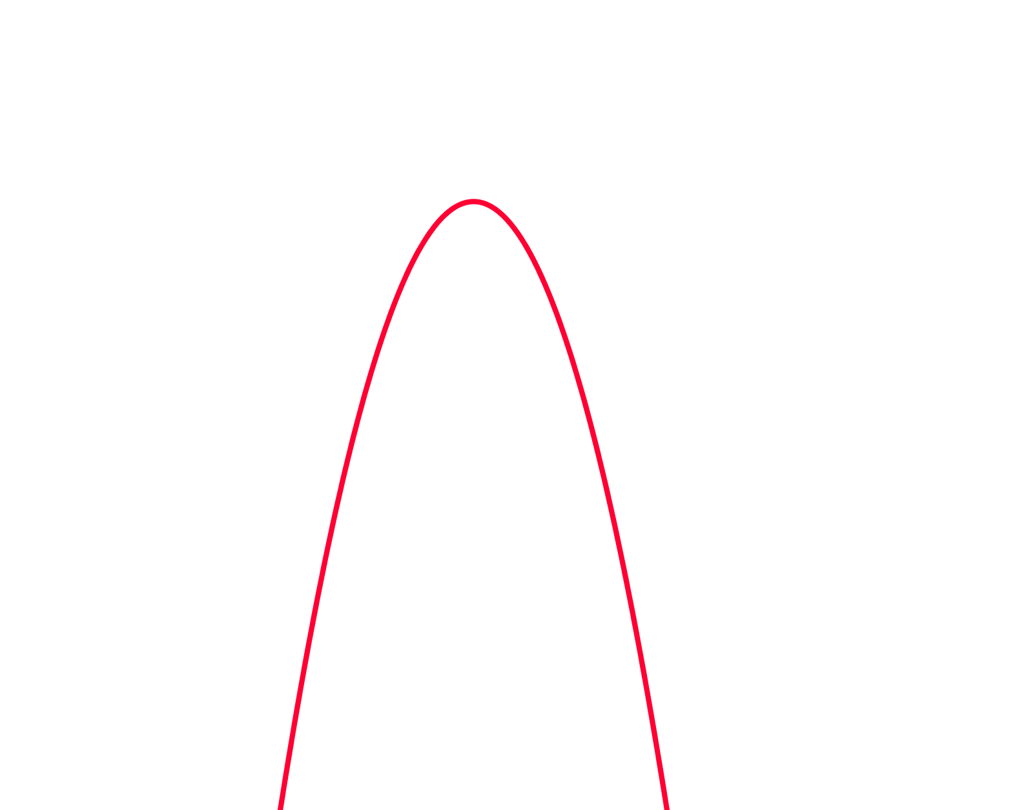
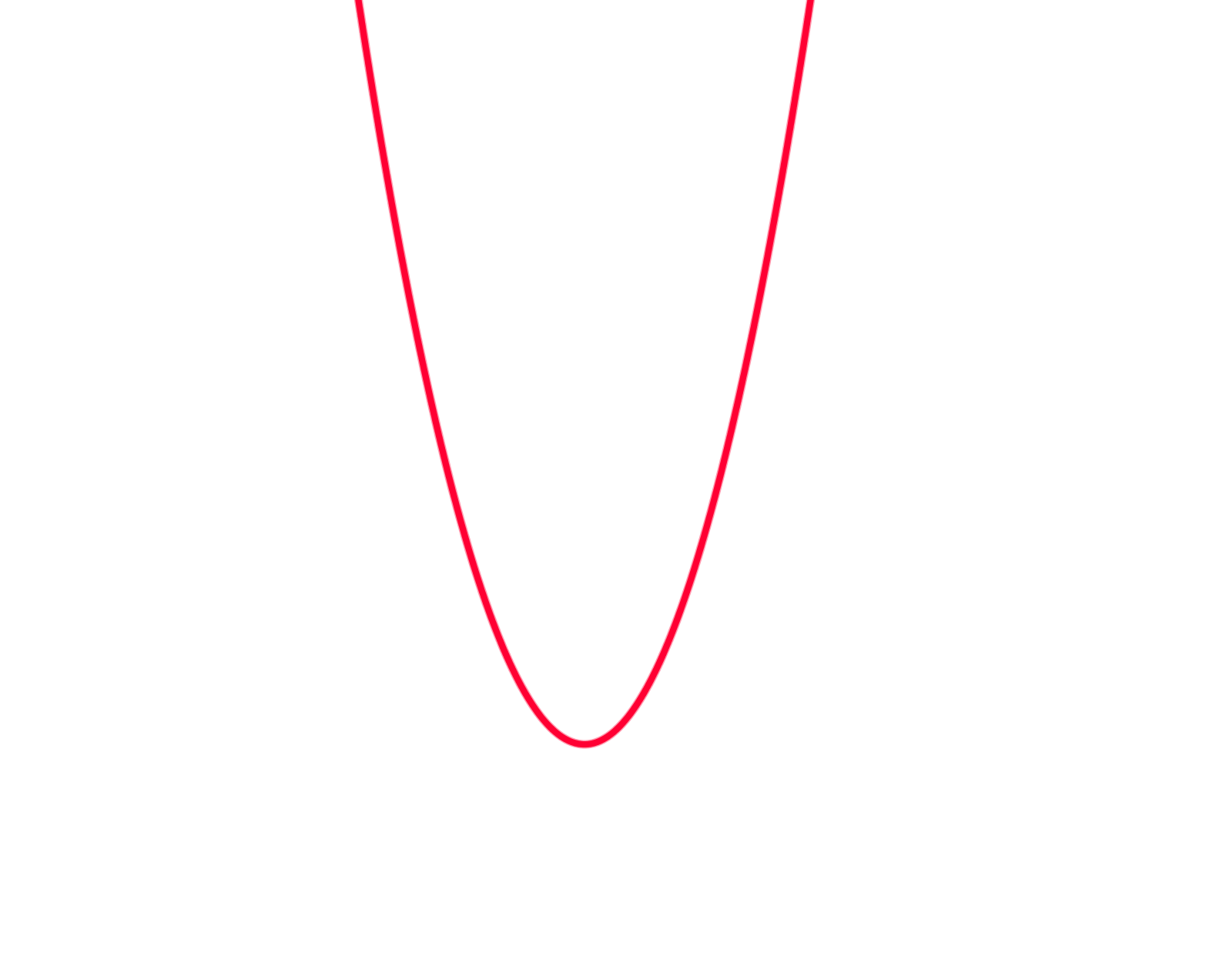


What is a parabola?
This is a positive parabola
This is a negative parabola
Can you think of where you might find a parabola in the real world?

Slide 3

Parabolas are also used in arches and architecture

Slide 4
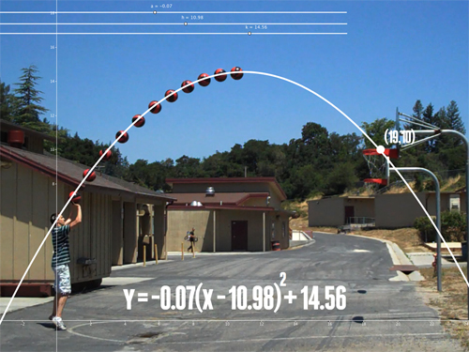
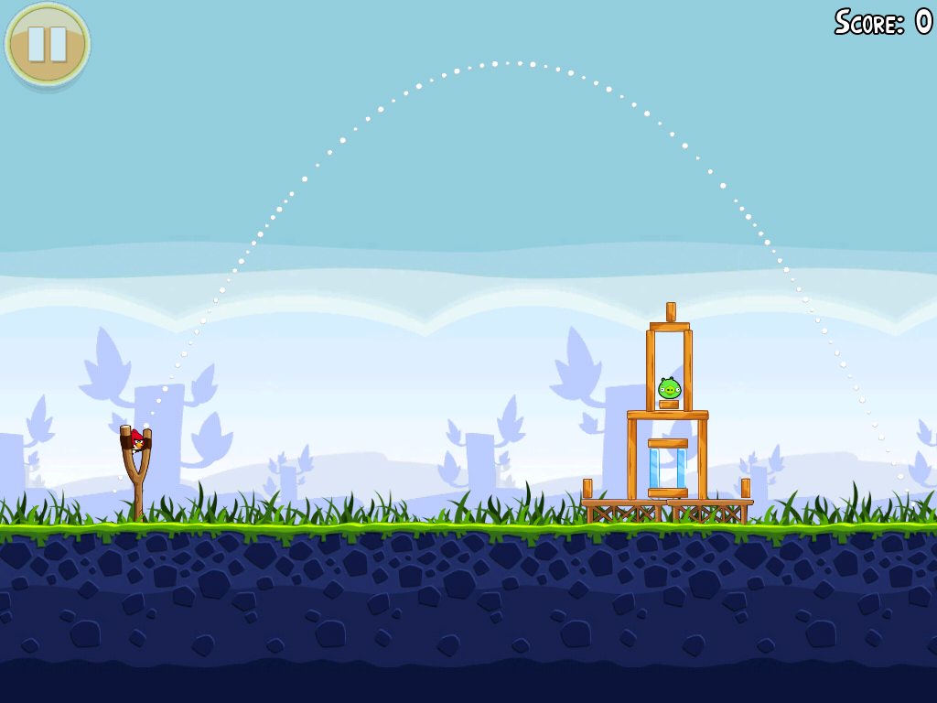
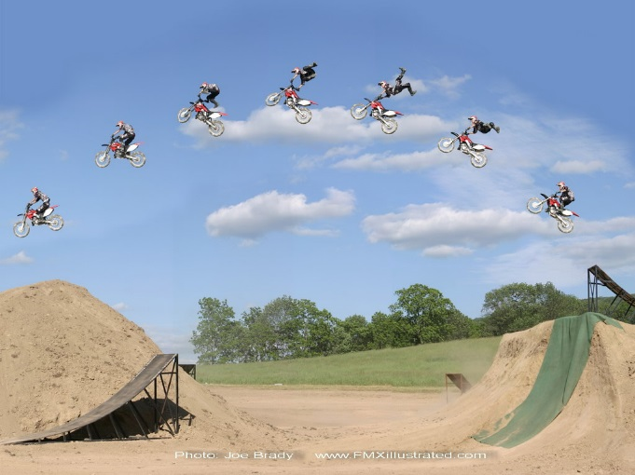
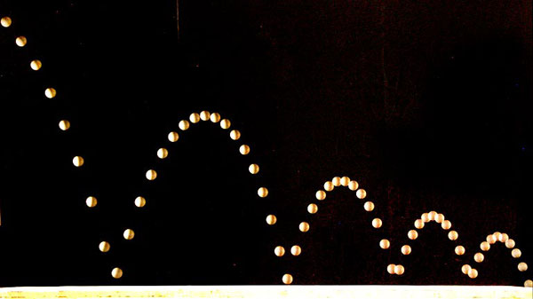
Objects affected by gravity follow a parabolic arc.

Slide 5
24
7
30
Topic: Graphing Quadratic Equation
Date
EQ – What information do we need to graph a parabola?
What is an quadratic equation?
A Quadratic equation has an x² as it’s highest power. When graphed it creates a shape called a parabola.
Examples are y = x²
y = 3x² + 2x + 6
y = -4x² – 5

Slide 6
24
7
30
Topic: Graphing Quadratic Equation
Date
EQ – What information do we need to graph a parabola?
Step 1. To graph a parabola create a table with x values
Step 2. Substitute the x values into the equation
Graph the equation y = x²
x | -3 | -2 | -1 | 0 | 1 | 2 | 3
y
y = x²
y = ( )²
y =
9

Slide 7
24
7
30
Topic: Graphing Quadratic Equation
Date
EQ – What information do we need to graph a parabola?
Step 1. To graph a parabola create a table with x values
Step 2. Substitute the x values into the equation
Graph the equation y = x²
x | -3 | -2 | -1 | 0 | 1 | 2 | 3
y | 9
y = x²
y = ( )²
y =
4

Slide 8
24
7
30
Topic: Graphing Quadratic Equation
Date
EQ – What information do we need to graph a parabola?
Step 1. To graph a parabola create a table with x values
Step 2. Substitute the x values into the equation
Graph the equation y = x²
x | -3 | -2 | -1 | 0 | 1 | 2 | 3
y | 9 | 4
1
0
1
4
9
y = x²
y = ( )²
y =

Slide 9
24
7
30
Topic: Graphing Quadratic Equation
Date
EQ – What information do we need to graph a parabola?
Step 1. To graph a parabola create a table with x values
Step 2. Substitute the x values into the equation
Graph the equation y = x²
x | -3 | -2 | -1 | 0 | 1 | 2 | 3
y | 9 | 4
1
0
1
4
9
This gives us the coordinates that we can graph.
(-3, 9), (-2, 4), (-1, 1), (0, 0), (1, 1), (2, 4), (3, 9)

Slide 10
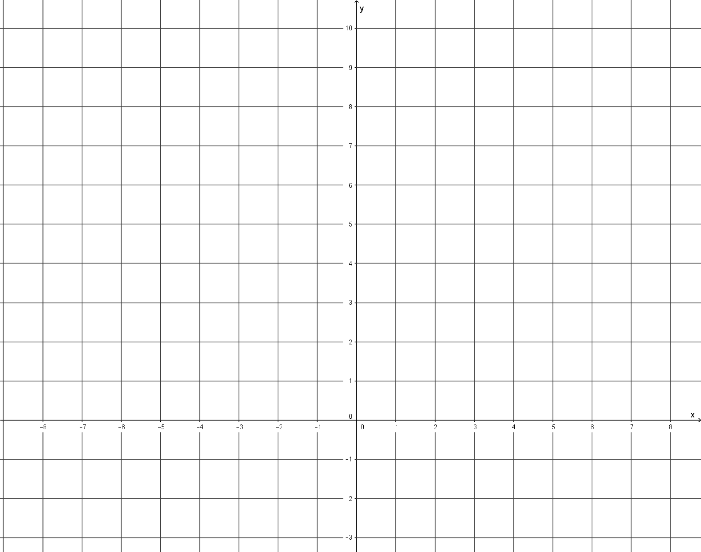
Eg. Graph the equation y = x²
x | -3 | -2 | -1 | 0 | 1 | 2 | 3
y
4
0
4
9
9
1
1
This gives us the coordinates that we can graph.
(-3, 9), (-2, 4), (-1, 1), (0, 0), (1, 1), (2, 4), (3, 9)
y
10
9
8
7
6
5
4
3
2
1
0
1
2
3
-10 -9 -8 -6 -5 -4 -3 -2 -1 0 1 2 3 4 5 6 7 8 9
X

Slide 11
Eg. Graph the equation y = x²
x | -3 | -2 | -1 | 0 | 1 | 2 | 3
y
4
1
0
4
9
9
1
This gives us the coordinates that we can graph.
(-3, 9), (-2, 4), (-1, 1), (0, 0), (1, 1), (2, 4), (3, 9)
y
y
10
9
8
7
6
5
4
3
2
1
0
1
2
3
-10 -9 -8 -6 -5 -4 -3 -2 -1 0 1 2 3 4 5 6 7 8 9
X

Slide 12
Eg. Graph the equation y = x²
x | -3 | -2 | -1 | 0 | 1 | 2 | 3
y
4
1
0
4
9
9
1
This gives us the coordinates that we can graph.
(-3, 9), (-2, 4), (-1, 1), (0, 0), (1, 1), (2, 4), (3, 9)
y
10
9
8
7
6
5
4
3
2
1
0
1
2
3
-10 -9 -8 -6 -5 -4 -3 -2 -1 0 1 2 3 4 5 6 7 8 9
X

Slide 13
Eg. Graph the equation y = x²
x | -3 | -2 | -1 | 0 | 1 | 2 | 3
y
4
1
0
4
9
9
1
This gives us the coordinates that we can graph.
(-3, 9), (-2, 4), (-1, 1), (0, 0), (1, 1), (2, 4), (3, 9)
y
10
9
8
7
6
5
4
3
2
1
0
1
2
3
-10 -9 -8 -6 -5 -4 -3 -2 -1 0 1 2 3 4 5 6 7 8 9
X

Slide 14
Eg. Graph the equation y = x²
x | -3 | -2 | -1 | 0 | 1 | 2 | 3
y
4
1
0
4
9
9
1
This gives us the coordinates that we can graph.
(-3, 9), (-2, 4), (-1, 1), (0, 0), (1, 1), (2, 4), (3, 9)
y
10
9
8
7
6
5
4
3
2
1
0
1
2
3
-10 -9 -8 -6 -5 -4 -3 -2 -1 0 1 2 3 4 5 6 7 8 9
X

Slide 15
Eg. Graph the equation y = x²
x | -3 | -2 | -1 | 0 | 1 | 2 | 3
y
4
1
0
4
9
9
1
This gives us the coordinates that we can graph.
(-3, 9), (-2, 4), (-1, 1), (0, 0), (1, 1), (2, 4), (3, 9)
y
10
9
8
7
6
5
4
3
2
1
0
1
2
3
-10 -9 -8 -6 -5 -4 -3 -2 -1 0 1 2 3 4 5 6 7 8 9
X

Slide 16
Eg. Graph the equation y = x²
x | -3 | -2 | -1 | 0 | 1 | 2 | 3
y
4
1
0
4
9
9
1
This gives us the coordinates that we can graph.
(-3, 9), (-2, 4), (-1, 1), (0, 0), (1, 1), (2, 4), (3, 9)
y
10
9
8
7
6
5
4
3
2
1
0
1
2
3
-10 -9 -8 -6 -5 -4 -3 -2 -1 0 1 2 3 4 5 6 7 8 9
X

Slide 17
Eg. Graph the equation y = x²
x | -3 | -2 | -1 | 0 | 1 | 2 | 3
y
4
1
0
4
9
9
1
This gives us the coordinates that we can graph.
(-3, 9), (-2, 4), (-1, 1), (0, 0), (1, 1), (2, 4), (3, 9)
y
10
9
8
7
6
5
4
3
2
1
0
1
2
3
-10 -9 -8 -6 -5 -4 -3 -2 -1 0 1 2 3 4 5 6 7 8 9
X

Slide 18
Eg. Graph the equation y = x²
x | -3 | -2 | -1 | 0 | 1 | 2 | 3
y
4
1
0
4
9
9
1
This gives us the coordinates that we can graph.
(-3, 9), (-2, 4), (-1, 1), (0, 0), (1, 1), (2, 4), (3, 9)
y
10
9
8
7
6
5
4
3
2
1
0
1
2
3
Now join the dots
-10 -9 -8 -6 -5 -4 -3 -2 -1 0 1 2 3 4 5 6 7 8 9
X

Slide 19
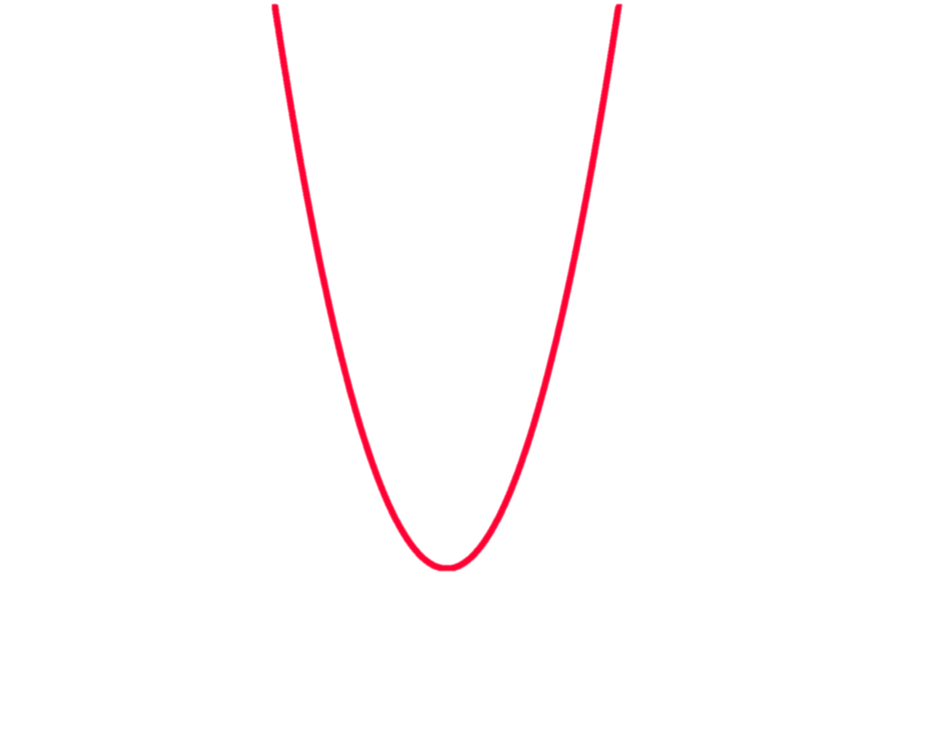
Eg. Graph the equation y = x²
x | -3 | -2 | -1 | 0 | 1 | 2 | 3
y
4
1
0
4
9
9
1
This gives us the coordinates that we can graph.
(-3, 9), (-2, 4), (-1, 1), (0, 0), (1, 1), (2, 4), (3, 9)
y
10
9
8
7
6
5
4
3
2
1
0
1
2
3
-10 -9 -8 -6 -5 -4 -3 -2 -1 0 1 2 3 4 5 6 7 8 9
X

Slide 20
Eg. Graph the equation y = x²
x | -3 | -2 | -1 | 0 | 1 | 2 | 3
y
4
1
0
4
9
9
1
This gives us the coordinates that we can graph.
(-3, 9), (-2, 4), (-1, 1), (0, 0), (1, 1), (2, 4), (3, 9)
y
10
9
8
7
6
5
4
3
2
1
0
1
2
3
Where the graph turns is called the turning point or vertex
-10 -9 -8 -6 -5 -4 -3 -2 -1 0 1 2 3 4 5 6 7 8 9
X

Slide 21
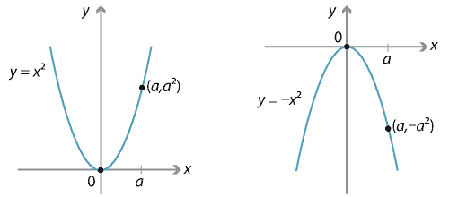
y = - x²
Gives an upside down parabola

Slide 22
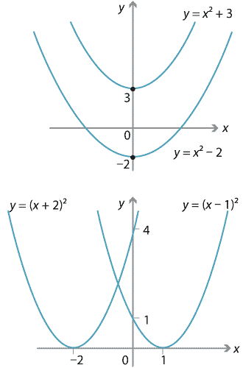
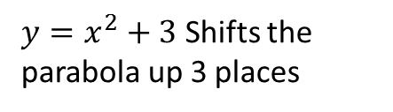
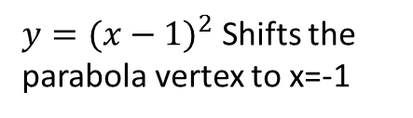
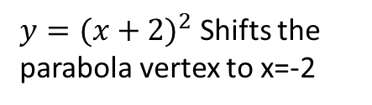
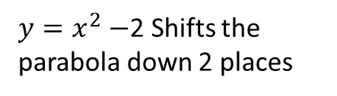
$y=x^{2}+3$ Shifts the parabola up 3 places
$y=x^{2}−$2 Shifts the parabola down 2 places
$y={(x+2)}^{2}$ Shifts the parabola vertex to x=-2
$y={(x−1)}^{2}$ Shifts the parabola vertex to x=-1

Slide 23
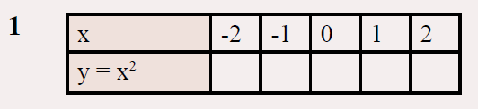
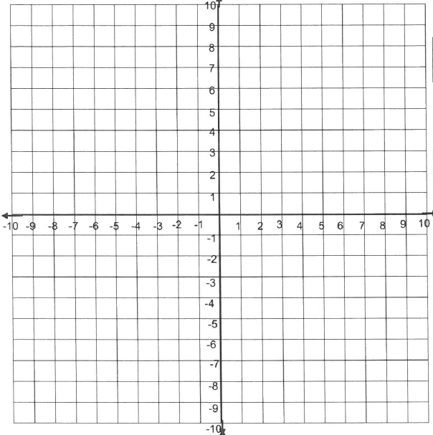
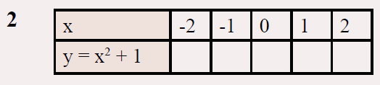
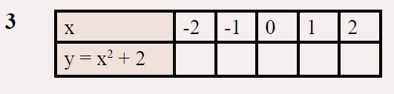
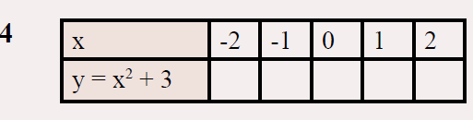
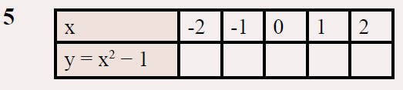
I will be collecting your work to mark!! Page 55 in the textbook

Slide 24
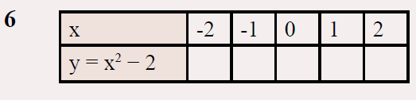
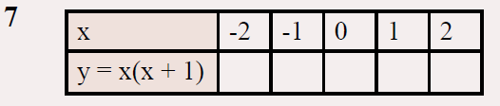
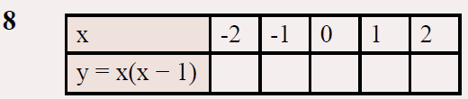
I will be collecting your work to mark!!

